Slide 1
Jermyn Borough Council Meeting
6/16/22

Slide 2
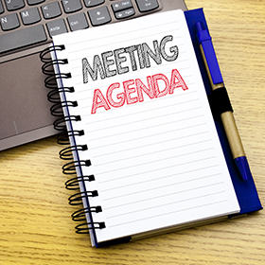
Meeting Agenda
June 16, 2022
CALL TO ORDER
PLEDGE OF ALLEGIANCE
ROLL CALL
PREVIOUS MEETING MINUTES
TREASURER REPORT/BILLS PAYABLE
CORRESPONDENCE
PUBLIC COMMENT
COMCAST
PROFESSIONAL REPORTS
POLICE
FIRE
EMA
SOLICITOR
CODE ENFORCEMENT
ZONING
ENGINEER
TAX COLLECTOR
MAYOR
COMMITTEE REPORTS
POLICE STUDY UPDATE-FRANK
JERMYN HEADSTART PLAYGROUND
R&L SITE
SAFETY OF WASHINGTON AVE TREES (PLANNING COMM CONCERN)
VACANCY BOARD APPOINTMENT
NEW BUSINESS

Slide 3
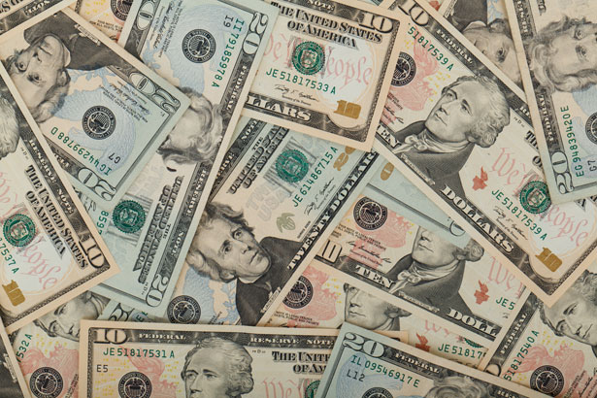
Treasurer’s report
6/16/22
ASSETS
Checking/Savings
Capital Reserve - DPW 10,726.47
Capital Reserve - Police 4,701.82
Crime Watch Fund 222.69
General Fund - Community 379,696.34
General Fund - FNB 5,265.62
Holiday Lights Fund 1,374.09

Slide 4
Treasurer’s report
Investment - General Fund 1,001.93
Investment - Liquid Fuels 33,827.86
Investment - Paving Fund 1,012.33
Investment - Recycling 5,005.46
Investment - Refuse 2,601.28
Liquid Fuels - FNB 53,751.10
Petty Cash 231.00
Recreations Fund 19,991.24
Recycling - Community 10,063.44
Refuse Checking - FNB 144,962.25
Total Checking/Savings 674,434.92

Slide 5
Treasurer’s report
200000 · Accounts Payable 29,722.62
Long Term Debt 328,205.09

